Slide 1
STAT 240 Review
Prepared by: Cameron Jones
Created Fall 2023, Adapted for Spring 2024

Slide 2
Unit 2: Data Visualization

Slide 3
Unit 2: Data Visualization
Which of the following geometries require TWO variables? (choose all that apply)
geom_bar
geom_col
geom_histogram
geom_density
FA23/SP24/SP24

Slide 4
Unit 2: Data Visualization
Which of the following geometries require TWO variables?
geom_bar
geom_col
geom_histogram
geom_density
Explanation:
Geom_bar automatically counts and plots the occurrences of a single categorical variable.
Geom_histogram automatically “bins” and plots the counts of occurrences of a single numeric variable.
Geom_density automatically produces a smooth curve similar to a histogram encoding the number of occurrences of a single numeric variable.
FA23/SP24

Slide 5
Unit 2: Data Visualization
You wish to visualize the distribution of Temperature (continuous) within each of 12 months. Should you facet by Temperature or Month?
FA23/SP24

Slide 6
Unit 2: Data Visualization
You wish to visualize the distribution of Temperature (continuous) within each of 12 months. Should you facet by Temperature or Month?
Explanation: One should facet by the categorical variable Month. Faceting generates a plot for each unique value of a variable, so it should be applied to categorical variables only.
FA23/SP24

Slide 7
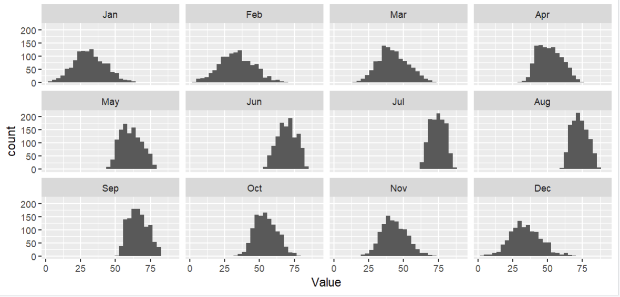
Unit 2: Data Visualization
Faceting Example
FA23/SP24

Slide 8
Unit 3: Dplyr

Slide 9
Unit 3: dplyr
Which of these commands may behave differently when preceded by group_by(something)? (choose all that apply)
select()
mutate()
slice_max()
summarize()
FA23/SP24

Slide 10
Unit 3: dplyr
Explanation: select() just keeps columns.
In mutate() and summarize(), expressions like mean() or n() will be evaluated at the group level if applicable, and over the entire dataframe otherwise.
Slice_max()with n=3 will give you 3 total rows without grouping, and 3 for each group with grouping
Which of these commands may behave differently when preceded by group_by(something)?
select()
mutate()
slice_max()
summarize()
FA23/SP24

Slide 11
Unit 3: dplyr
“myData” has 50 rows, and a categorical variable “group” which has 5 different values. How many rows will the result of this command have?
myData %>% group_by(group) %>% mutate(nRows = n())
FA23/SP24

Slide 12
Unit 3: dplyr
“myData” has 50 rows, and a categorical variable “group” which has 5 different values. How many rows will the result of this command have?
myData %>% group_by(group) %>% mutate(nRows = n())
Explanation: It will still have 50! mutate() always just adds a column, the group_by() only affects the values it puts in that column.
FA23/SP24

Slide 13
Unit 3: dplyr *
“df1” has 5 rows, and “df2” has 4 rows; they have a variable in common, and 3 rows each which would automatically match.
Rank the following by how many rows the resulting dataframe would have. (least -> most)
left_join(df1, df2)
Right_join(df1, df2)
Inner_join(df1, df2)
Full_join(df1, df2)
FA23/SP24

Slide 14
Unit 3: dplyr *
“df1” has 5 rows, and “df2” has 4 rows; they have a variable in common, and 3 rows each which would automatically match.
Rank the following by how many rows the resulting dataframe would have. (least -> most)
left_join(df1, df2)
Right_join(df1, df2)
Inner_join(df1, df2)
Full_join(df1, df2)
Explanation:
inner_join keeps all rows which match in both dataframes (3). Right_join keeps only the rows in the second dataframe (4). Left_join keeps only the rows in the first dataframe (5). Full_join keeps all rows in both frames (3 that match, 2 others from df1, 1 other from df2 = 6)
FA23/SP24

Slide 15
Units 4/5: Lubridate + Pivoting

Slide 16
Units 4/5: Lubridate + Pivoting
month(ydm(“2002-1-2”), label = TRUE) would return what?
1
Jan
2
Feb
FA23/SP24

Slide 17
Units 4/5: Lubridate + Pivoting
month(ydm(“2002-1-2”), label = TRUE) would return what?
1
Jan
2
Feb
Explanation:
The internal date is “y” (2002, the year) “d” (1st of the month), “m” (2nd month, February).
Extracting the month from February 1st, 2002 with label = TRUE gives “Feb” instead of 2.
FA23/SP24

Slide 18
Units 4/5: Lubridate + Pivoting *
Which of these statements are true about applying pivot_longer to a dataframe? (choose all that apply)
It can decrease the number of rows from what it was before.
It can increase the number of rows.
It can decrease the number of columns.
It can increase the number of columns.
FA23/SP24

Slide 19
Units 4/5: Lubridate + Pivoting *
Which of these statements are true about applying pivot_longer to a dataframe? (choose all that apply)
It can decrease the number of rows from what it was before.
It can increase the number of rows.
It can decrease the number of columns.
It can increase the number of columns.
Explanation:
Pivot_longer() takes X columns and spreads them out across two columns and X rows. The dataframe gets longer vertically (more rows) and narrower horizontally (less columns).
The question is worded like this because if you only pivot two columns, the number of columns will technically stay the same.
FA23/SP24

Slide 20
Units 4/5: Lubridate + Pivoting
myData currently has two rows for every U.S. state (100 total) (variable name state); one row representing the married people in that state, and one row representing non-married people, indicated by the variable marriageStatus. There is a column income which stores the average income of the people in that state-marriage combination. Write out the command which would transform myData into a dataframe with one row for every state, and a column each for avg. income among married and non-married people.
FA23/SP24

Slide 21
Units 4/5: Lubridate + Pivoting
myData currently has two rows for every U.S. state (100 total) (variable name state); one row representing the married people in that state, and one row representing non-married people, indicated by the variable marriageStatus. There is a column income which stores the average income of the people in that state-marriage combination. Write out the command which would transform myData into a dataframe with one row for every state, and a column each for avg. income among married and non-married people.
myData %>% pivot_wider(
names_from = marriageStatus, values_from = income)
We want to take the two rows for each state, defined by marriageStatus, and pivot them wider into one row for each state with two columns; the names of those columns will represent married & non-married respectively, and their values will come from the old income column.
FA23/SP24

Slide 22
Unit 6: Stringr

Slide 23
Unit 6: Stringr *
Match these stringr commands to the type of object they return.
Str_detect
Str_extract
Str_sub
Str_count
Logical (T/F)
Numeric
String
FA23/SP24

Slide 24
Unit 6: Stringr *
Match these stringr commands to the type of object they return.
Str_detect: Logical. T/F showing if your pattern is in the target string.
Str_extract: String. Returns the actual string that matched your pattern, NA otherwise.
Str_sub: String. Allows you to “slice” sections out of a string.
Str_count: Numeric. Counts number of times your pattern appears in the target strong.
FA23/SP24

Slide 25
Unit 6: Stringr
Fill in the following expression, which filters the dataframe myData by the content of the column word, to KEEP those rows where word ENDS with exactly: one or more of the letter “s”, then a digit, then the end of the string.
myData %>% filter(str_detect(word, “???”))
FA23/SP24

Slide 26
Unit 6: Stringr
Fill in the following expression, which filters the dataframe myData by the content of the column word, to KEEP those rows where word ENDS with exactly: one or more of the letter “s”, then a digit.
myData %>% filter(str_detect(word, “???”))
Explanation:
“s+\\d$”
Or
“s+[:digit:]$”
The “+” means match the previous token, which was “s”, one or more times. \\d or [:digit:] means any digit, $ means end of string.
FA23/SP24

Slide 27
Unit 7: Basic Probability Theory

Slide 28
Unit 7: Basic Probability Theory
Fill in the blank to make this a valid probability distribution.
X | 1 | 2 | 3 | 4 | 5
P(X=x) | 0.1 | ? | 0.3 | 0.3 | 0.1
FA23/SP24

Slide 29
Unit 7: Basic Probability Theory
Solution: The sum of the probabilities in a discrete distribution must be 1.
X | 1 | 2 | 3 | 4 | 5
P(X=x) | 0.1 | 0.2 | 0.3 | 0.3 | 0.1
FA23/SP24

Slide 30
Unit 7: Basic Probability Theory
Write down an expression (no need to simplify) for the mean of the following probability distribution.
X | 1 | 2 | 3 | 4 | 5
P(X=x) | 0.1 | 0.2 | 0.3 | 0.3 | 0.1
FA23/SP24

Slide 31
Unit 7: Basic Probability Theory
Write down an expression for the mean of the following probability distribution.
Explanation:
(1 * 0.1) + (2 * 0.2) + (3 * 0.3) + (4 * 0.3) + (5 * 0.1). The mean of a (discrete) probability distribution is found by multiplying every possible value of X by its probability, and summing those products up.
X | 1 | 2 | 3 | 4 | 5
P(X=x) | 0.1 | 0.2 | 0.3 | 0.3 | 0.1
FA23/SP24

Slide 32
Unit 7: Basic Probability Theory *
Find the cumulative probability at each x (the CDF).
X | 1 | 2 | 3 | 4 | 5
P(X=x) | 0.1 | 0.2 | 0.3 | 0.3 | 0.1
X | 1 | 2 | 3 | 4 | 5
P(X<=x) | ? | ? | ? | ? | ?
FA23/SP24

Slide 33
Unit 7: Basic Probability Theory *
Find the cumulative probability at each x (the CDF).
X | 1 | 2 | 3 | 4 | 5
P(X=x) | 0.1 | 0.2 | 0.3 | 0.3 | 0.1
X | 1 | 2 | 3 | 4 | 5
P(X<=x) | 0.1 | 0.3 | 0.6 | 0.9 | 1
FA23/SP24

Slide 34
Unit 7: Basic Probability Theory
Find the cumulative probability at each x (the CDF).
X | 1 | 2 | 3 | 4 | 5
P(X=x) | 0.1 | 0.2 | 0.3 | 0.3 | 0.1
X | 1 | 2 | 3 | 4 | 5
P(X<=x) | 0.1 | 0.3 | 0.6 | 0.9 | 1
FA23/SP24

Slide 35
Unit 7: Basic Probability Theory
Find the cumulative probability at each x (the CDF).
X | 1 | 2 | 3 | 4 | 5
P(X=x) | 0.1 | 0.2 | 0.3 | 0.3 | 0.1
X | 1 | 2 | 3 | 4 | 5
P(X<=x) | 0.1 | 0.3 | 0.6 | 0.9 | 1
FA23/SP24

Slide 36
Unit 7: Basic Probability Theory
What is the 0.8 quantile of this distribution?
X | 1 | 2 | 3 | 4 | 5
P(X<=x) | 0.1 | 0.3 | 0.6 | 0.9 | 1
Notice: still cumulative probability, not pointwise
FA23/SP24

Slide 37
Unit 7: Basic Probability Theory
What is the 0.8 quantile of this distribution?
X | 1 | 2 | 3 | 4 | 5
P(X<=x) | 0.1 | 0.3 | 0.6 | 0.9 | 1
Explanation: 4 is the first X value which achieves AT LEAST 0.8 cumulative probability, so it is the 0.8 quantile. It is also the p-quantile for all p greater than 0.6 up to and including 0.9.
FA23/SP24

Slide 38
Unit 8: Binomial & Normal Distributions

Slide 39
Unit 8: Binomial & Normal Distributions
Consider bowling a ball at ten bowling pins, and let X be the total number of pins knocked down.
Does X follow a binomial distribution? Why or why not?
FA23/SP24

Slide 40
Unit 8: Binomial & Normal Distributions
Consider bowling a ball at ten bowling pins, and let X be the total number of pins knocked down.
Does X follow a binomial distribution? Why or why not?
Explanation:
No. All four assumptions must be met for X to be Binomial, and at least one is not met.
B: Binary outcome. This is assumption is valid: every pin either falls (success) or doesn’t (failure).
I: Independence. This assumption is NOT valid. One pin being knocked over is more likely to knock over other pins. (For example, you can’t knock down a middle pin without at least one other one.)
N: Fixed number of trials. This assumption is valid; there are exactly 10 pins.
S: Same probability for each trial. This one is debatable. One could argue the central pins are more likely to fall than the outside pins, but it is unclear. However, it doesn’t matter, because independence is already clearly violated.
FA23/SP24

Slide 41
Unit 8: Binomial and Normal Distributions
Let X ~ Binom(n, p).
Which of the following returns P(1 < X <= 4)?
pbinom(4, n, p) – pbinom(1, n, p)
pbinom(5, n, p) – pbinom(0, n, p)
pbinom(4, n, p) – pbinom(2, n, p)
pbinom(3, n, p) – pbinom(1, n, p)
FA23/SP24

Slide 42
Unit 8: Binomial and Normal Distributions
Let X ~ Binom(n, p).
Which of the following returns P(1 < X <= 4)?
pbinom(4, n, p) – pbinom(1, n, p)
pbinom(5, n, p) – pbinom(0, n, p)
pbinom(4, n, p) – pbinom(2, n, p)
pbinom(3, n, p) – pbinom(1, n, p)
pbinom(x, n, p) gives P(Binom(n, p) <= x). We want the area under 4, 3, and 2 (1 not included). We take all the area under and to the left of 4, and subtract all the area under and to the left of 1.
FA23/SP24

Slide 43
Unit 8: Binomial & Normal Distributions *
True or False: These two commands will return the same value.
dbinom(0, size = 5, prob = 0.2)
pbinom(0, size = 5, prob = 0.2)
FA23/SP24

Slide 44
Unit 8: Binomial & Normal Distributions *
True or False: These two commands will return the same value.
dbinom(0, size = 5, prob = 0.2)
pbinom(0, size = 5, prob = 0.2)
Explanation:
True.
dbinom() gives P(X=x), and pbinom() gives P(X<=x), so generally not the same. But the binomial distribution can only go as low as 0 (all trials fail), so P(X=0) = P(X<=0) for binomial variables!
FA23/SP24

Slide 45
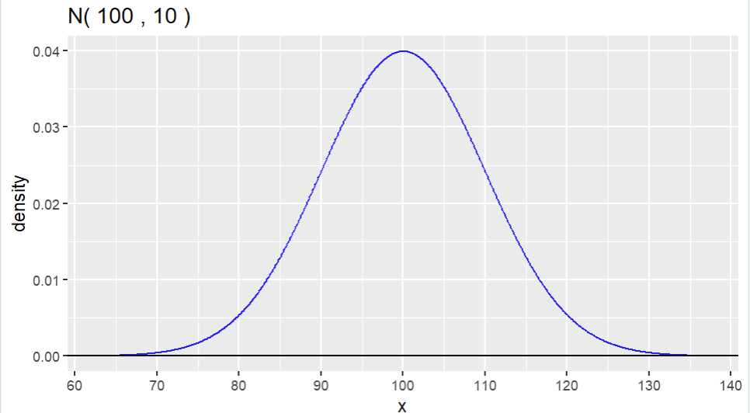
Unit 8: Binomial & Normal Distributions
What is your best guess of the mean and standard deviation of this Normal distribution?
FA23/SP24

Slide 46
Unit 8: Binomial & Normal Distributions
Explanation:
The mean is 100 (the center of the distribution) and the standard deviation is 10. In a normal distribution, 95% of the data is within two standard deviations of the mean; which increases to over 99% when you extend out to three standard deviations.
95% within 2 SD’s of mean
FA23/SP24

Slide 47
Unit 8: Binomial & Normal Distributions *
Write out R code which would compute P(35 <= X <= 50), where
X ~ Normal(40, 5).
FA23/SP24

Slide 48
Unit 8: Binomial & Normal Distributions *
Write out R code which would compute
P(35 <= X < 50), where
X ~ Normal(40, 5).
Explanation:
pnorm(50, 40, 5) – pnorm(35, 40, 5)
The first term is all the area to the left of 50; the second term is all the area to the left of 35. When you subtract the two, you are left with the area in between them. There is no need to adjust here – continuous areas, caution to the wind!
FA23/SP24

Slide 49
Unit 9: Inference on Proportions

Slide 50
Unit 9: Inference on Proportions
The following slides will take us through an example hypothesis test and then confidence interval for a difference in proportions on some made-up data.
Question of interest: Is there a difference in the proportion of people who are left-handed among basketball players and non-players?
FA23/SP24

Slide 51
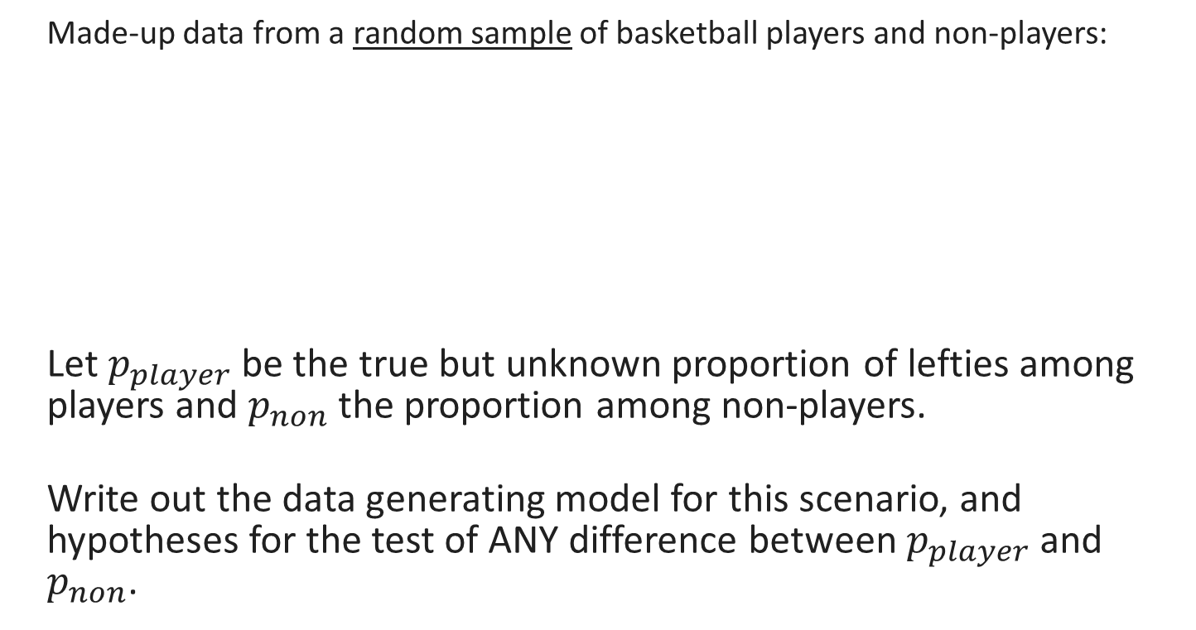
Unit 9: Inference on Proportions
Made-up data from a random sample of basketball players and non-players:
Let $p_{player}$ be the true but unknown proportion of lefties among players and $p_{non}$ the proportion among non-players.
Write out the data generating model for this scenario, and hypotheses for the test of ANY difference between $p_{player}$ and $p_{non}$.
 | Left-Handed | Total
Basketball Players | 49 | 538
Non-Players | 64 | 500
FA23/SP24

Slide 52
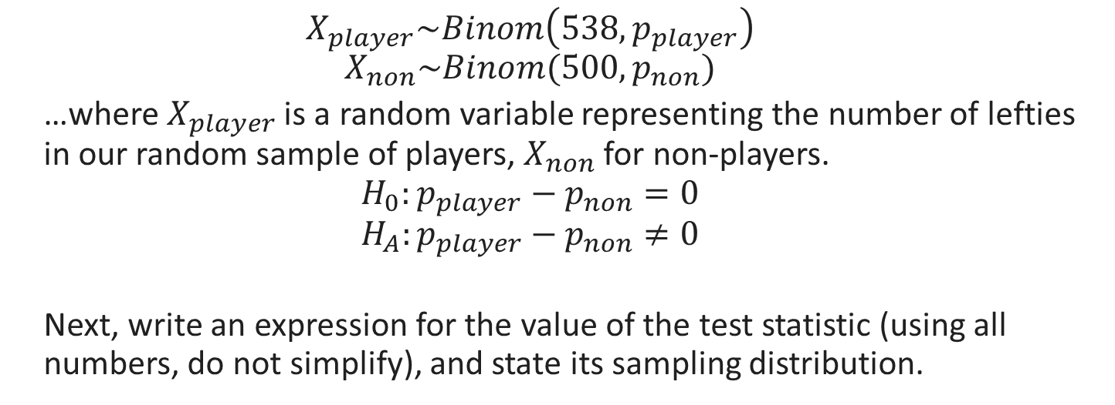
Unit 9: Inference on Proportions
 | Left-Handed | Total
Basketball Players | 49 | 538
Non-Players | 64 | 500
$$X_{player}\sim Binom\left(538, p_{player}\right)$$
$$X_{non}\sim Binom(500, p_{non})$$
…where $X_{player}$ is a random variable representing the number of lefties in our random sample of players, $X_{non}$ for non-players.
$$H_{0}:p_{player}−p_{non}=0$$
$$H_{A}:p_{player}−p_{non}≠0$$
Next, write an expression for the value of the test statistic (using all numbers, do not simplify), and state its sampling distribution.
FA23/SP24

Slide 53

Unit 9: Inference on Proportions
 | Left-Handed | Total
Basketball Players | 49 | 538
Non-Players | 64 | 500
$$z= \frac{\frac{49}{538}−\frac{64}{500}−0}{SE}\sim N(0,1)$$
$$SE= \sqrt{\frac{\overline{p}(1−\overline{p})}{538}+\frac{\overline{p}(1−\overline{p})}{500}}$$
$$\overline{p}=\frac{49+64}{538+500}$$
FA23/SP24

Slide 54

Unit 9: Inference on Proportions
 | Left-Handed | Total
Basketball Players | 49 | 538
Non-Players | 64 | 500
Assume the correct value of the test statistic from the previous question is -1.91. Write out R code which would compute the p-value for this test ($H_{A}:p_{player}−p_{non}≠0$).
FA23/SP24

Slide 55
Unit 9: Inference on Proportions
2*pnorm(-1.91)
Why 2*? Because the alternative hypothesis is that the true parameter is not equal to 0, so extremes in either direction from the sampling distribution are evidence for it, and the normal distribution is symmetric so the left tail and right tail will have equal area.
Why not 1- or lower.tail = FALSE? We would need that if the observed value of the test statistic was positive, so we could calculate area to its right and double that. However, it is negative, so we calculate area to its left (which is what pnorm does by default) and double that.
FA23/SP24

Slide 56
Unit 9: Inference on Proportions
Assume the correct p-value is 0.056. Using alpha = 0.05, interpret this p-value in context, with statistical evidence briefly included in parentheses at the end.
FA23/SP24

Slide 57
Unit 9: Inference on Proportions
We fail to find evidence that the true proportion of lefties is different among basketball players and non-players. (p = 0.056, two-sided test for difference in proportions)
OR,
The data are consistent with there being no difference in the true proportion of lefties among basketball players and non-players. (p = 0.056, two-sided test for difference in proportions) (I prefer the top one; it is easier to remember, because it is the same sentence you write for a significant p-value, but with “fail to” added.)
(DO NOT WRITE: “We fail to reject the null hypothesis.” While this is true, it is not in context.)
FA23/SP24

Slide 58

Unit 9: Inference on Proportions
 | Left-Handed | Total
Basketball Players | 49 | 538
Non-Players | 64 | 500
Write out an expression for a 95% confidence interval for $p_{player}−p_{non}$ with the Agresti-Coffe adjustment. Include an R expression to calculate the critical value exactly.
FA23/SP24

Slide 59

Unit 9: Inference on Proportions
 | Left-Handed | Total
Basketball Players | 49 | 538
Non-Players | 64 | 500
$$\left(\frac{49+1}{538+2}−\frac{64+1}{500+2}\right)±z∗\sqrt{\frac{\frac{49+1}{538+2}(1−\frac{49+1}{538+2})}{538+2}+\frac{\frac{64+1}{500+2}(1−\frac{64+1}{500+2})}{500+2}}$$
Where z, the critical value, can be computed with qnorm(0.975).
FA23/SP24

Slide 60
Unit 10: Inference on Means

Slide 61
Unit 10: Inference on Means
The following slides will take us through an example hypothesis test and then confidence interval for a difference in means on some made-up data.
Question of interest: Is there evidence the true average height (in inches) of corn plants given a special growth treatment is GREATER than that of corn plants given water?
FA23/SP24

Slide 62

Unit 10: Inference on Proportions
Made-up data from a random sample of corn plants:
Let $μ_{treatment}$ be the true but unknown average height of corn plants receiving special treatment, and$μ_{water}$ the same for watered plants.
Write out the data generating model for this scenario, and hypotheses for the test that the treatment is better (produces taller plants) than water.
 | Average | Std. Dev | N
Special Treatment | 84.2 | 4.2 | 14
Water | 80.8 | 3.4 | 13
FA23/SP24

Slide 63
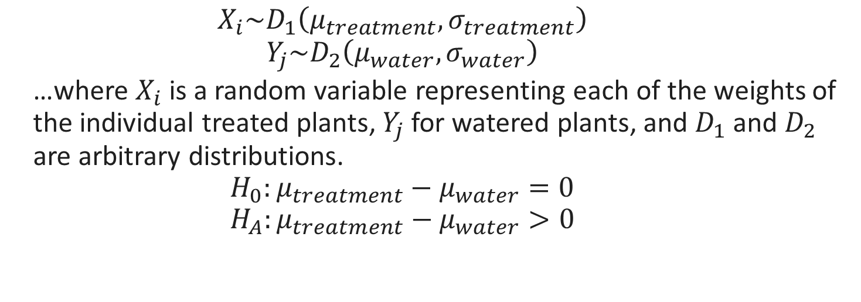
Unit 10: Inference on Means
 | Average | Std. Dev | N
Special Treatment | 84.2 | 4.2 | 14
Water | 80.8 | 3.4 | 13
$$X_{i}\sim D_{1}\left(μ_{treatment}, σ_{treatment}\right)$$
$$Y_{j}\sim D_{2}\left(μ_{water}, σ_{water}\right)$$
…where $X_{i}$ is a random variable representing each of the weights of the individual treated plants, $Y_{j}$ for watered plants, and $D_{1}$ and $D_{2}$ are arbitrary distributions.
$$H_{0}:μ_{treatment}−μ_{water}=0$$
$$H_{A}:μ_{treatment}−μ_{water}>0$$
FA23/SP24

Slide 64
Unit 10: Inference on Means
 | Average | Std. Dev | N
Special Treatment | 84.2 | 4.2 | 14
Water | 80.8 | 3.4 | 13
Next, write an expression for the value of the test statistic (using numbers, do not simplify), and state its sampling distribution.
FA23/SP24

Slide 65
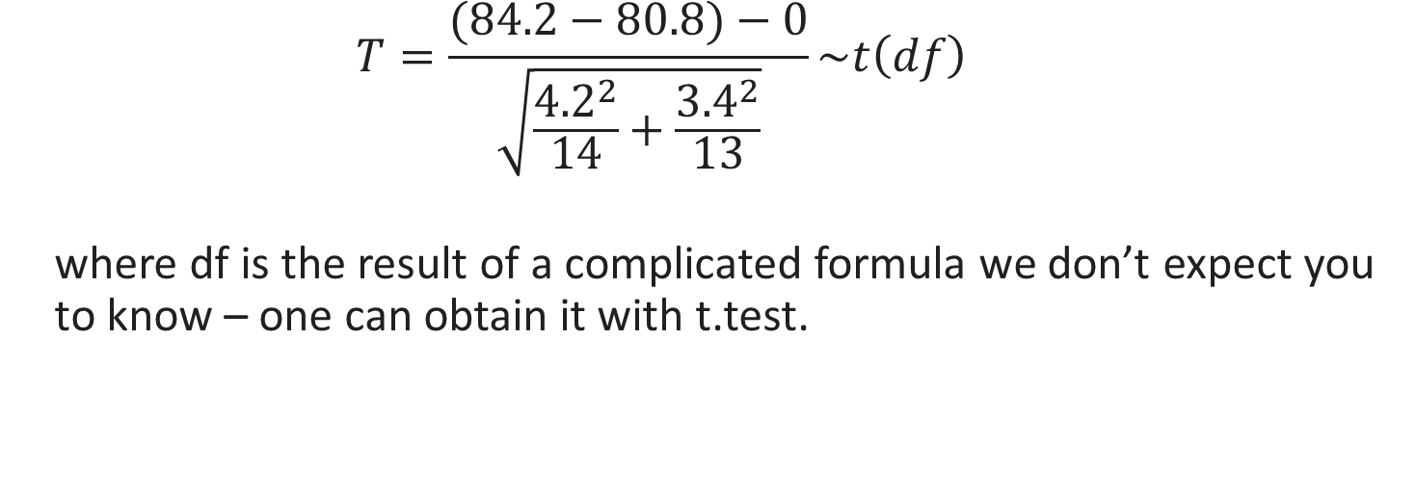
Unit 10: Inference on Means
 | Average | Std. Dev | N
Special Treatment | 84.2 | 4.2 | 14
Water | 80.8 | 3.4 | 13
$$T=\frac{(84.2−80.8)−0}{\sqrt{\frac{{4.2}^{2}}{14}+\frac{{3.4}^{2}}{13}}}\sim t\left(df\right)$$
where df is the result of a complicated formula we don’t expect you to know – one can obtain it with t.test.
FA23/SP24

Slide 66
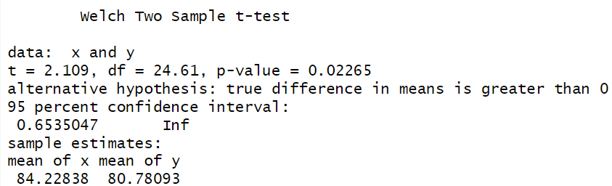
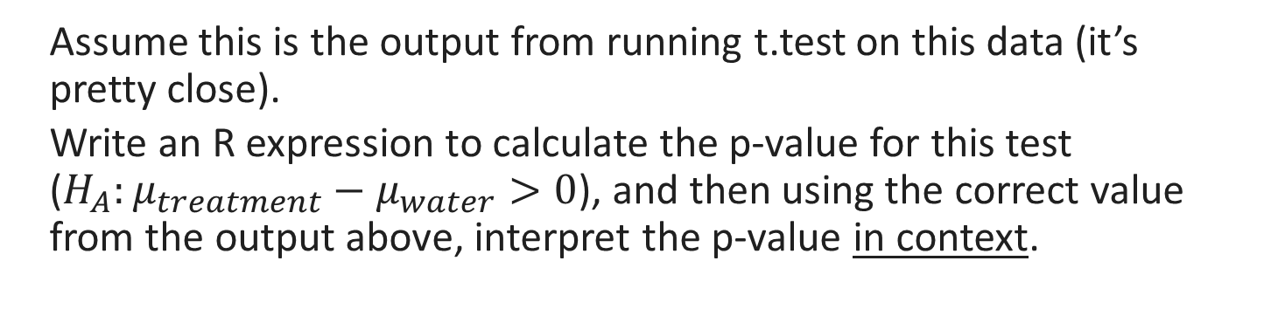
Unit 10: Inference on Means
Assume this is the output from running t.test on this data (it’s pretty close).
Write an R expression to calculate the p-value for this test ($H_{A}:μ_{treatment}−μ_{water}>0$), and then using the correct value from the output above, interpret the p-value in context.
FA23/SP24

Slide 67
Unit 10: Inference on Means
1-pt(2.109, df = 24.61)
Why not 2*? Because the alternative hypothesis was >, so we don’t take both tails, only the right extreme.
Why 1-? Because we want the area to the right of 2.109, which is positive, and pt() gives area to the left by default.
We find significant evidence that the special treatment increases the average weight of corn plants compared to water alone. (p = 0.02, t-test for difference in means)
FA23/SP24

Slide 68
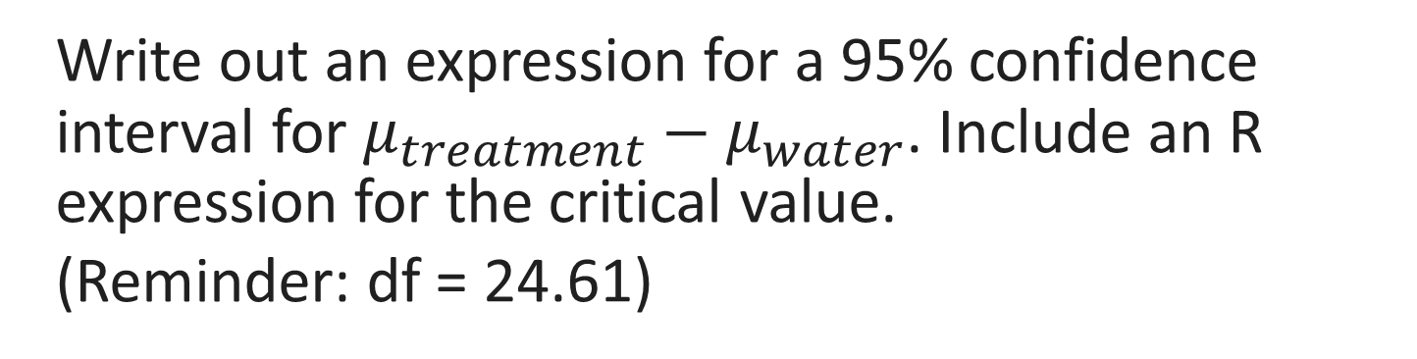
Unit 10: Inference on Means
 | Average | Std. Dev | N
Special Treatment | 84.2 | 4.2 | 14
Water | 80.8 | 3.4 | 13
Write out an expression for a 95% confidence interval for $μ_{treatment}−μ_{water}$. Include an R expression for the critical value.
(Reminder: df = 24.61)
FA23/SP24

Slide 69
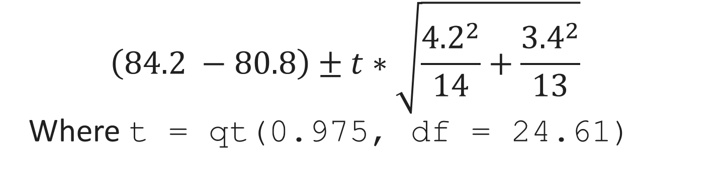
Unit 10: Inference on Means
 | Average | Std. Dev | N
Special Treatment | 84.2 | 4.2 | 14
Water | 80.8 | 3.4 | 13
$$\left(84.2 −80.8\right)±t∗\sqrt{\frac{{4.2}^{2}}{14}+\frac{{3.4}^{2}}{13}}$$
Where t = qt(0.975, df = 24.61)
FA23/SP24

Slide 70
Unit 11: Linear Regression Intro

Slide 71
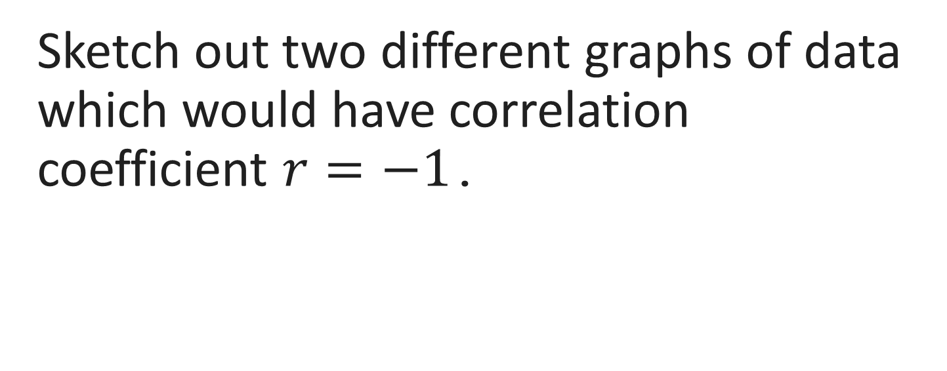
Unit 11: Linear Regression Intro *
Sketch out two different graphs of data which would have correlation coefficient $r=−1$.
FA23/SP24

Slide 72
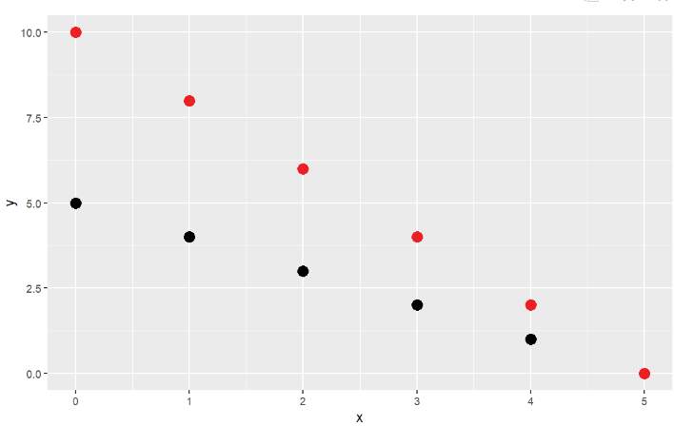
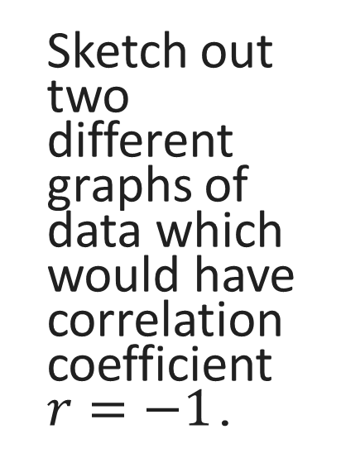
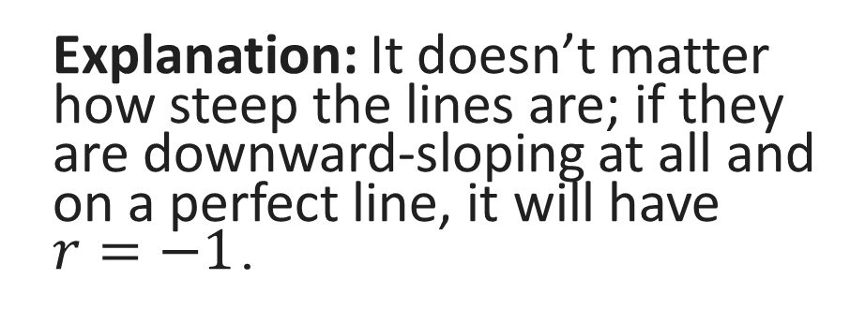
Unit 11: Linear Regression Intro *
Explanation: It doesn’t matter how steep the lines are; if they are downward-sloping at all and on a perfect line, it will have $r=−1$.
Sketch out two different graphs of data which would have correlation coefficient $r=−1$.
FA23/SP24

Slide 73
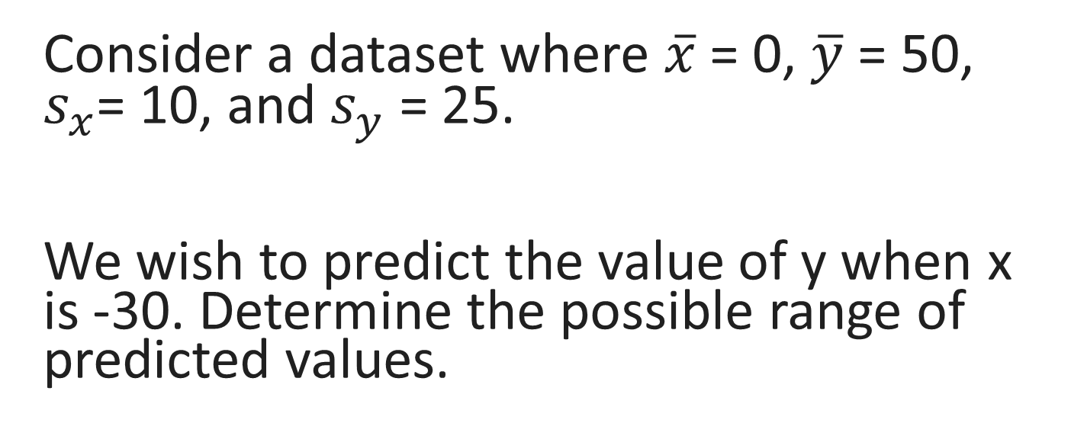
Unit 11: Linear Regression Intro
Consider a dataset where $\overline{x}$ = 0, $\overline{y}$ = 50, $s_{x}$= 10, and $s_{y}$ = 25.
We wish to predict the value of y when x is -30. Determine the possible range of predicted values.
FA23/SP24

Slide 74
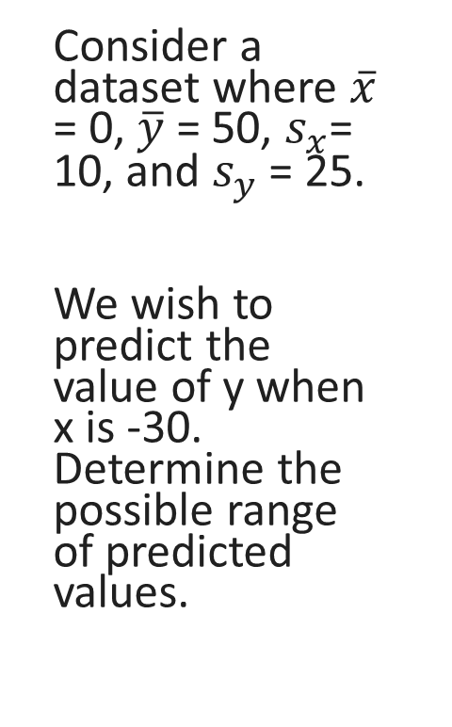
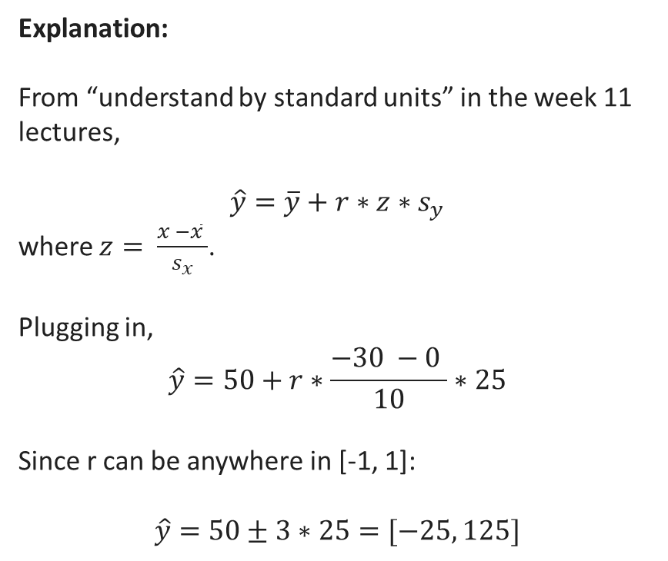
Unit 11: Linear Regression Intro
Consider a dataset where $\overline{x}$ = 0, $\overline{y}$ = 50, $s_{x}$= 10, and $s_{y}$ = 25.
We wish to predict the value of y when x is -30. Determine the possible range of predicted values.
Explanation:
From “understand by standard units” in the week 11 lectures,
$$\hat{y}=\overline{y}+r∗z∗s_{y}$$
where $z= \frac{x −\overline{x} }{s_{x}}$.
Plugging in,
$$\hat{y}=50+r∗\frac{−30 −0 }{10}∗25$$
Since r can be anywhere in [-1, 1]:
$$\hat{y}=50±3∗25=[−25, 125]$$
FA23/SP24

Slide 75
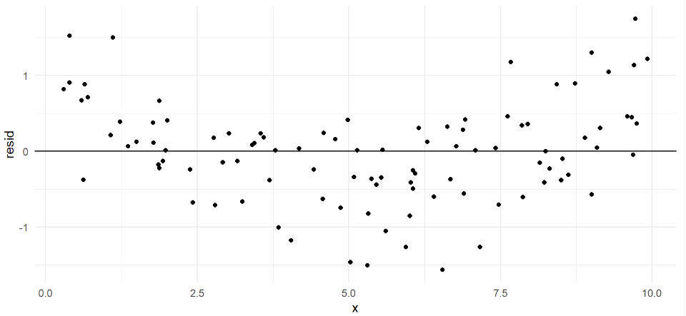
Unit 11: Linear Regression Intro
Which, if any, of the linear regression assumptions are violated in the plot below?
FA23/SP24

Slide 76
Unit 11: Linear Regression Intro
Linearity is violated; there is a clear curve pattern.
FA23/SP24

Slide 77
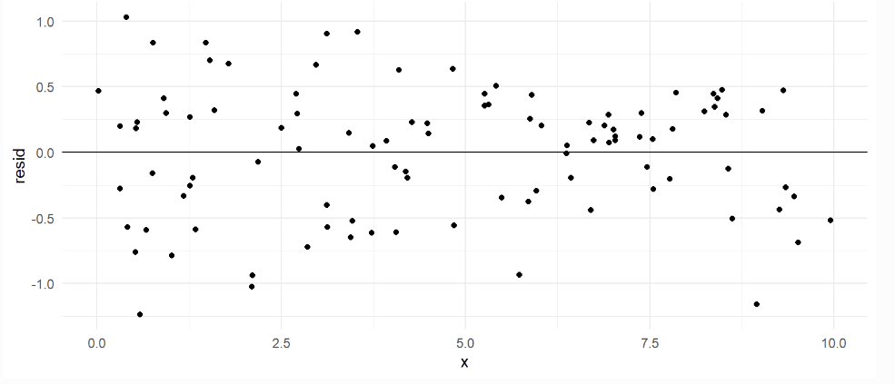
Unit 11: Linear Regression Intro
Which, if any, of the linear regression assumptions are violated in the plot below?
FA23/SP24

Slide 78
Unit 11: Linear Regression Intro
All assumptions are satisfied. There is no curve, the residuals seem normally distributed around the line, and there is no obvious spreading out or in.
FA23/SP24

Slide 79
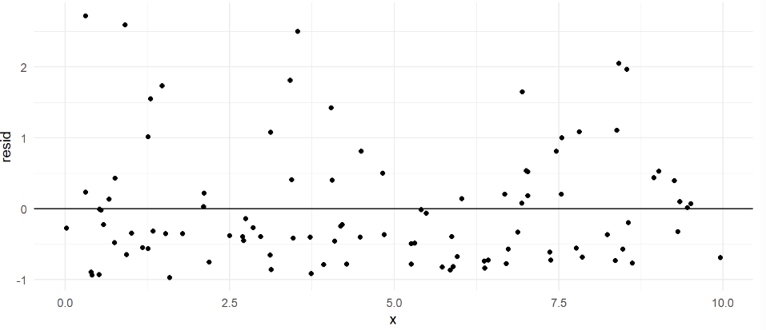
Unit 11: Linear Regression Intro
Which, if any, of the linear regression assumptions are violated in the plot below?
FA23/SP24

Slide 80
Unit 11: Linear Regression Intro
Normal errors around 0 is violated; the residuals are not symmetric, they are skewed positive.
FA23/SP24

Slide 81
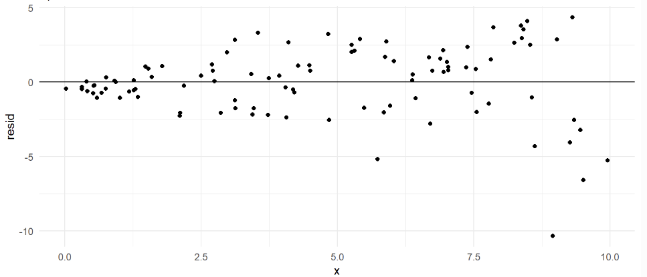
Unit 11: Linear Regression Intro
Which, if any, of the linear regression assumptions are violated in the plot below?
FA23/SP24

Slide 82
Unit 11: Linear Regression Intro
Constant variance is violated; the points fan out as you move right.
FA23/SP24

Slide 83
Unit 12: Linear Regression Inference

Slide 84
Unit 12: Linear Regression Inference
The following slides will take us through an example of linear regression inference. The dataset women is built into R, and contains heights and weights for a random sample 15 American women in their 30’s. We wish to test for the existence of a relationship between height (input) and weight (response).
FA23/SP24

Slide 85
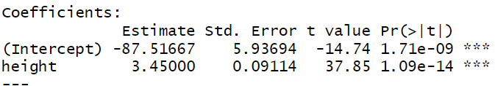
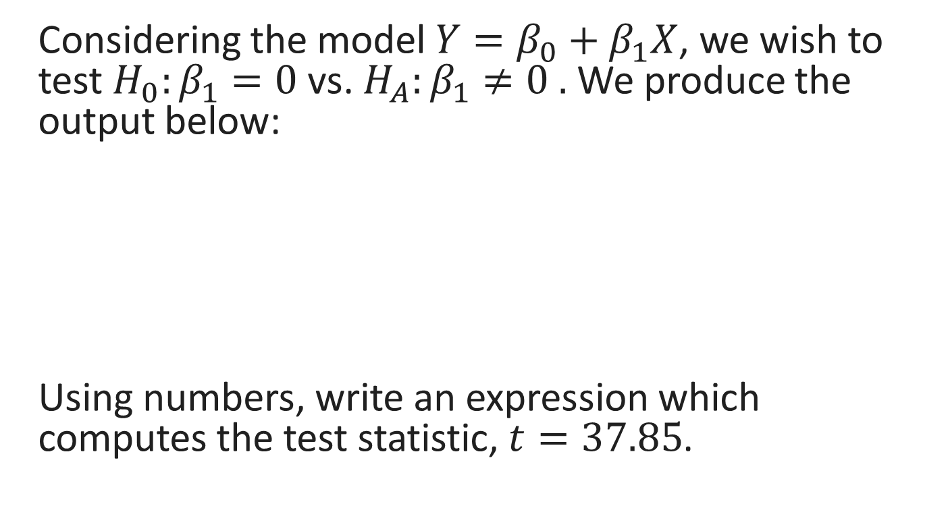
Unit 12: Linear Regression Inference
Considering the model $Y=β_{0}+β_{1}X$, we wish to test $H_{0}:β_{1}=0$vs. $H_{A}:β_{1}≠0 .$ We produce the output below:
Using numbers, write an expression which computes the test statistic, $t=37.85$.
FA23/SP24

Slide 86
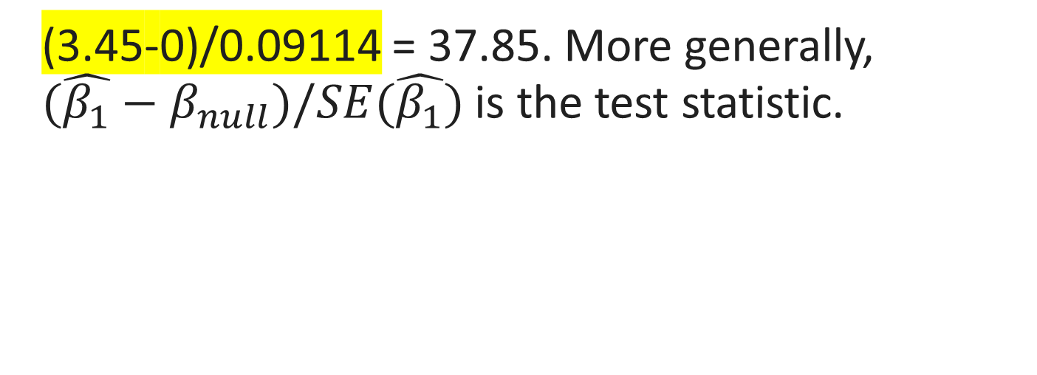
Unit 12: Linear Regression Inference
(3.45-0)/0.09114 = 37.85. More generally, ${(\hat{β_{1}}−β}_{null})/SE(\hat{β_{1}})$ is the test statistic.
FA23/SP24

Slide 87
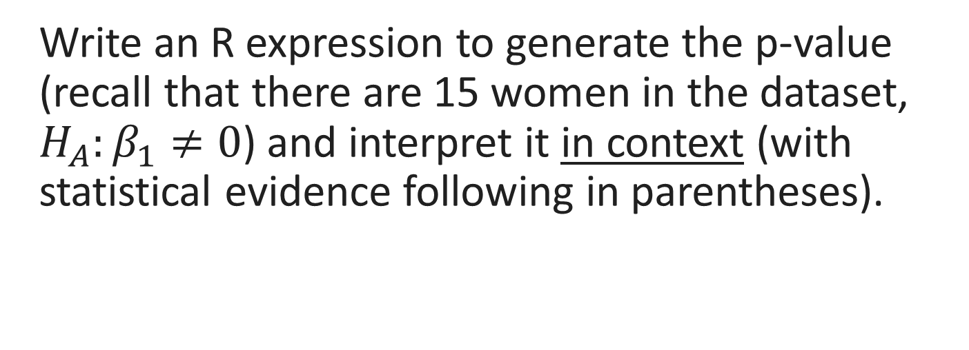
Unit 12: Linear Regression Inference
Write an R expression to generate the p-value (recall that there are 15 women in the dataset, $H_{A}:β_{1}≠0$) and interpret it in context (with statistical evidence following in parentheses).
FA23/SP24

Slide 88
Unit 12: Linear Regression Inference
2*(1-pt(37.85, df = 15-2))
2* because we have a two-tailed test; 1- because we need area to the right of 37.85 (which then gets doubled).
We find strong evidence for a relationship between height and weight among American women in their 30s (p = 1.09e-14, linear regression).
FA23/SP24

Slide 89
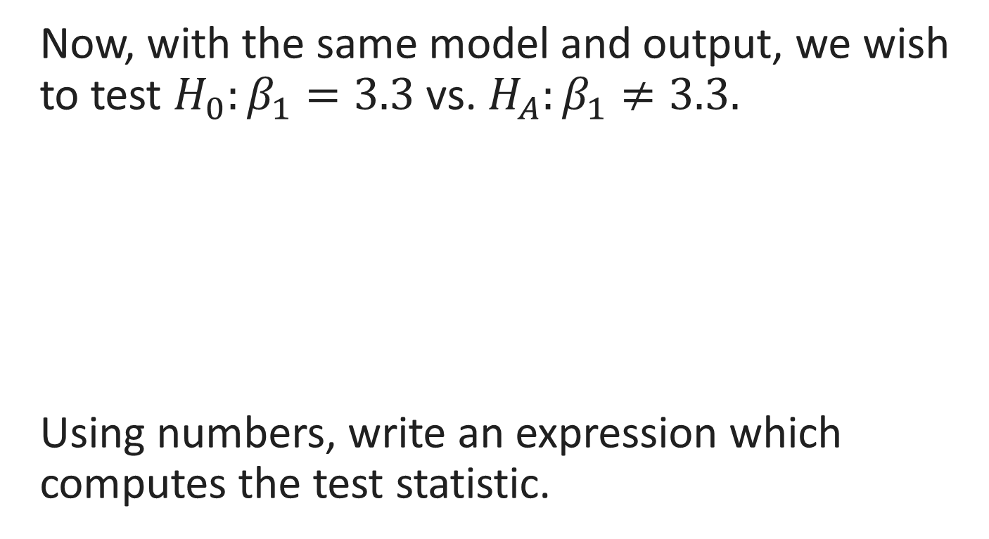
Unit 12: Linear Regression Inference
Now, with the same model and output, we wish to test $H_{0}:β_{1}=3.3$vs. $H_{A}:β_{1}≠3.3.$
Using numbers, write an expression which computes the test statistic.
FA23/SP24

Slide 90
Unit 12: Linear Regression Inference
(3.45-3.3)/0.09114.
FA23/SP24

Slide 91
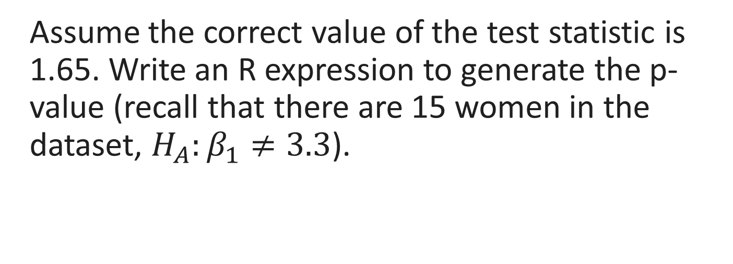
Unit 12: Linear Regression Inference
Assume the correct value of the test statistic is 1.65. Write an R expression to generate the p-value (recall that there are 15 women in the dataset, $H_{A}:β_{1}≠3.3$).
FA23/SP24

Slide 92
Unit 12: Linear Regression Inference
2*(1-pt(1.65, df = 15-2))
2* because we have a two-tailed test; 1- because we need area to the right of 37.85 (which then gets doubled).
FA23/SP24

Slide 93
Unit 12: Linear Regression Inference
Assume the correct p-value evaluates to 0.12. Using alpha = 0.05, interpret the p-value in context (followed by statistical evidence in parentheses).
FA23/SP24

Slide 94
Unit 12: Linear Regression Inference
We fail to find evidence that the true slope of the line relating the height and weight of American women in their 30s is not 3.3.
OR,
The data are consistent with the true slope of the line relating the height and weight of American women in their 30s being 3.3.
(It is hard to avoid statistical jargon)
FA23/SP24

Slide 95
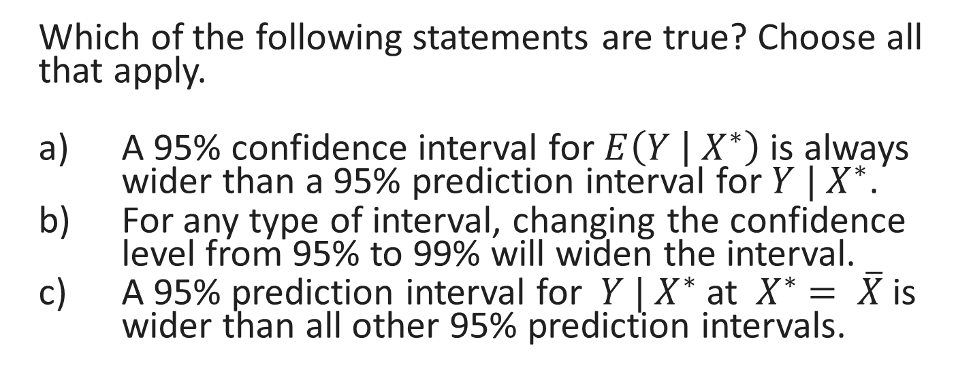
Unit 12: Linear Regression Inference
Which of the following statements are true? Choose all that apply.
A 95% confidence interval for $E\left(Y | { X}^{∗}\right)$ is always wider than a 95% prediction interval for $Y | X^{∗}$.
For any type of interval, changing the confidence level from 95% to 99% will widen the interval.
A 95% prediction interval for ${ Y | X}^{∗}$at ${ X}^{∗} = \overline{X}$ is wider than all other 95% prediction intervals.
FA23/SP24

Slide 96
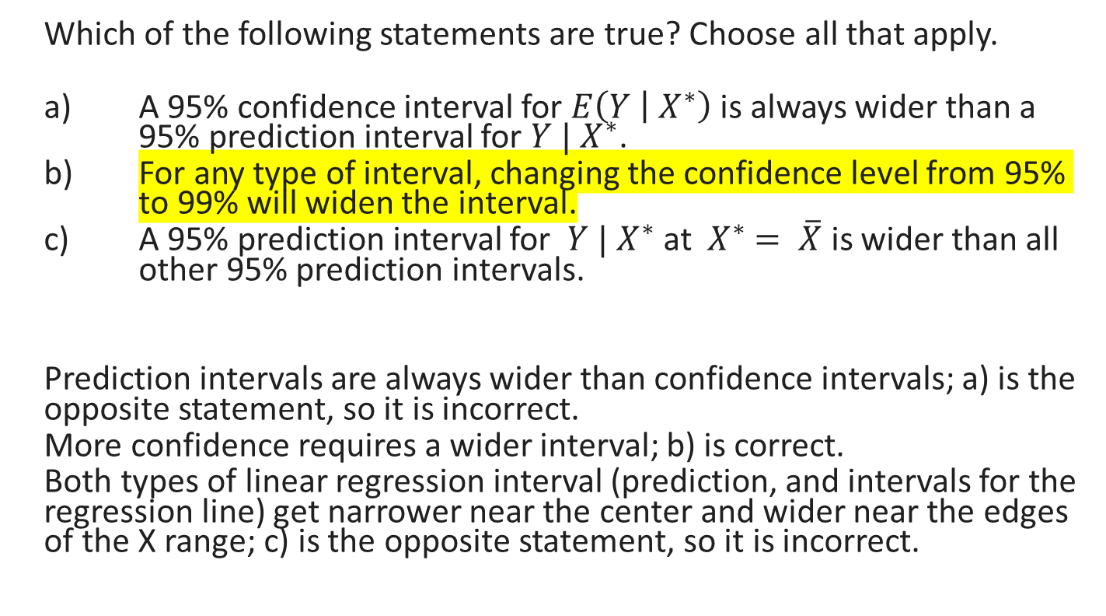
Unit 12: Linear Regression Inference
Which of the following statements are true? Choose all that apply.
A 95% confidence interval for $E\left(Y | { X}^{∗}\right)$ is always wider than a 95% prediction interval for $Y | X^{∗}$.
For any type of interval, changing the confidence level from 95% to 99% will widen the interval.
A 95% prediction interval for ${ Y | X}^{∗}$at ${ X}^{∗} = \overline{X}$ is wider than all other 95% prediction intervals.
Prediction intervals are always wider than confidence intervals; a) is the opposite statement, so it is incorrect.
More confidence requires a wider interval; b) is correct.
Both types of linear regression interval (prediction, and intervals for the regression line) get narrower near the center and wider near the edges of the X range; c) is the opposite statement, so it is incorrect.
FA23/SP24

